Slide 1
The Autonomous Crawl Space Inspection Robot
Team Members: Jim Camp, John Harris, JC Williams, and Joseph Thomas
Faculty Advisor: Mr. Jesse Roberts

Slide 2
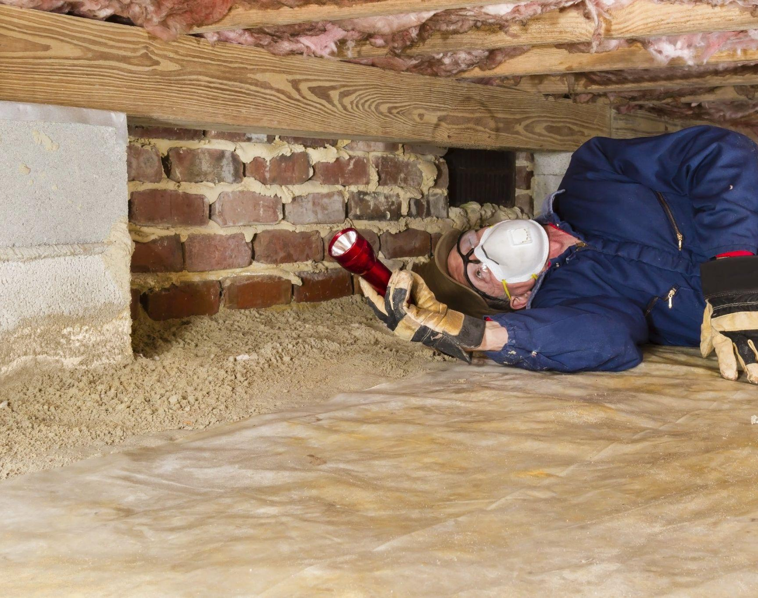
Industry Impact
Standard Crawl Space Inspections Require a Professional
Crawl Spaces are Inhospitable and Dangerous
Croomba is an Invaluable Tool for the Automation of the Procedure
Notes:
Home inspections require a trained, licensed professional crawl underneath a building to gather information on the home’s status. This takes a long time, and the environment is certainly inhospitable and sometimes dangerous. The Croomba has the potential to become an invaluable tool for the home inspection industry by automating the task of crawl space inspection, and a fleet of robots could survey multiple sites simultaneously

Slide 3
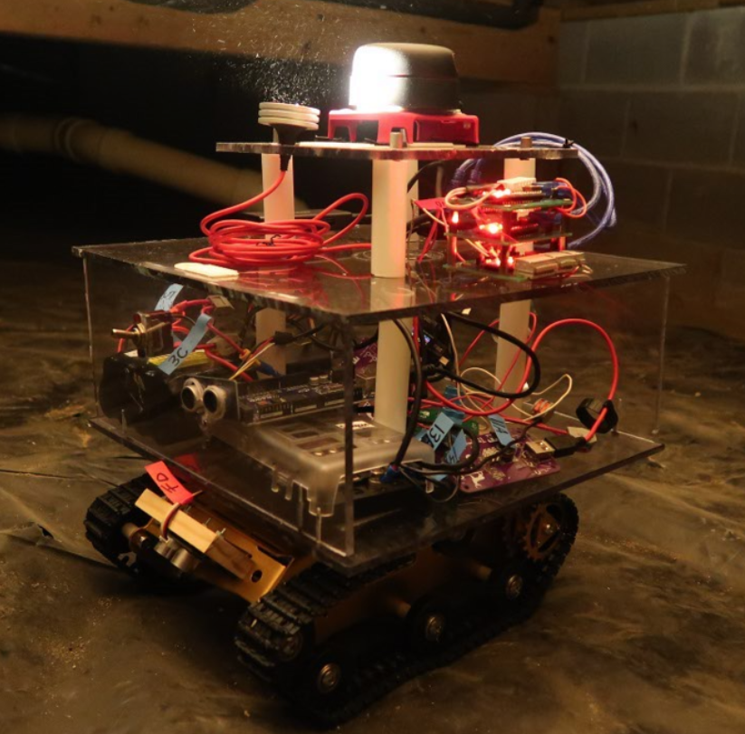
Project Overview
Autonomous Crawl Space Inspection
Create Map, Take Pictures, Record Sensor Data
Prepare Future Renditions
Modularity and Standards
Notes:
The objective of the Croomba project is to create a robot capable of inspecting a crawl space autonomously while also taking pictures and recording sensor data throughout. We have designed, ordered, and built the robot hardware while also setting up programs to demonstrate basic functionality. The team has also integrated features for improvements with future editions of the Croomba. We made the designs with a focus on modularity to allow for a concentration on atomic subsystems while also keeping the appropriate industry standards in mind.
Now John will give a high level look into our designs

Slide 4
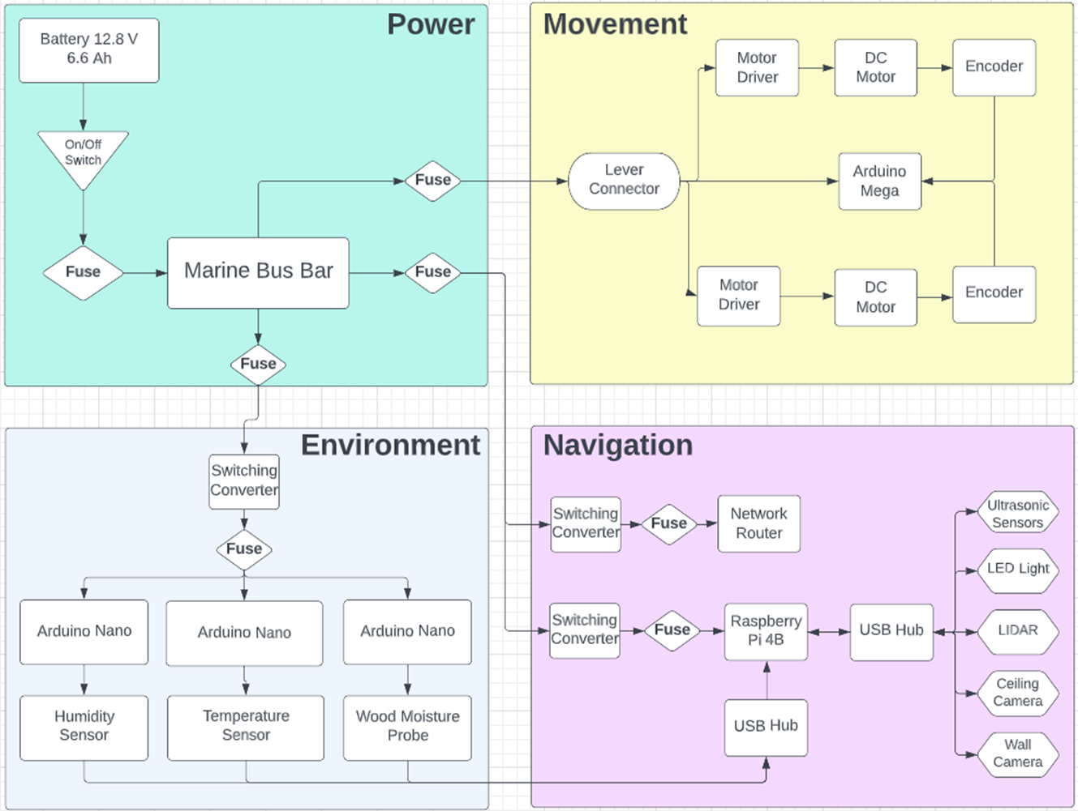
High Level Design
Notes:
This is our high level design. Again, we divided the project into 4 subsystem, and each of us was responsible for designing and assembling one of these subsystems you see here. Joseph did the Movement system. Jim did the environmental sensing, JC did the Navigational System, and I did the power system (SLIDE)

Slide 5
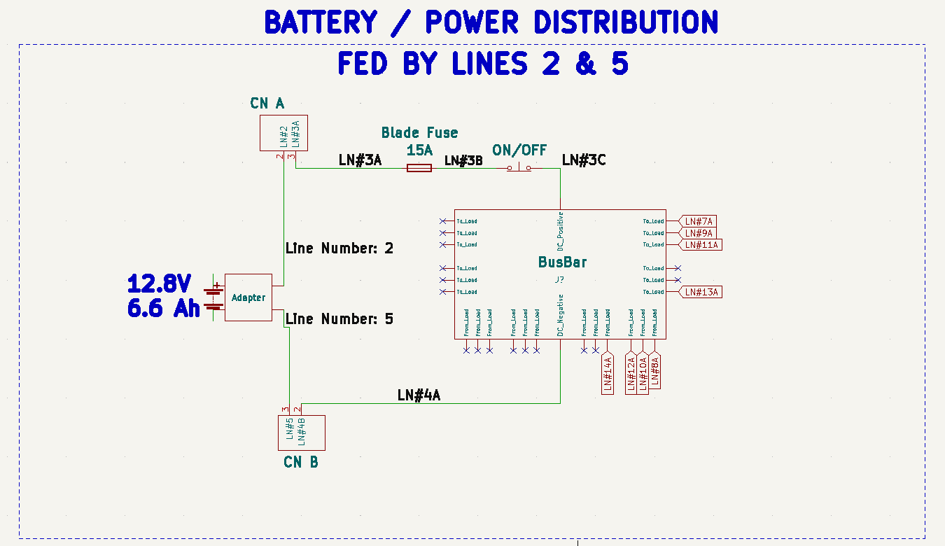
Power Subsystem
Safety
Durability
Versatility
Notes:
“Early in our design process we identified the power subsystem as needing the most thought toward failure modes and Risk Mitigation.
We used the National Electric Code [Table 310.16 Ampacities of Insulated Conductors & 310.15(C)1 Adjustment Factors for more than three current carrying conductors] as a guide for choosing wire gauges. The system has several different gauges of wire, but lines connected to the bus bar are either 12 gauge solid core or 14 gauge stranded aluminum core [of type THWN which stands for Thermoplastic Heat and Water-resistant Nylon-coated wire rated for 75 degrees celsius.]
We chose an improvised semi enclosed case for the proof of concept due to budget constraints, but future work may include using a NEMA (which stands for the national electrical manufacturers association) type 2 or higher case.
You can see HERE on this slide that line numbers have been added to the schematic for third party buildability, and we marked them with colored tags in the robot. (RoHS restriction of hazardous substances non compliant for proof of concept)
The power is distributed on a marine bus bar HERE with integrated fuses and LED indicator lights for when a fuse is blown. In addition to the integrated fuses there are redundant blade fuses on the power lines and a safety ON/OFF switch conveniently located on the outer chassis for emergency shut downs.

Slide 6
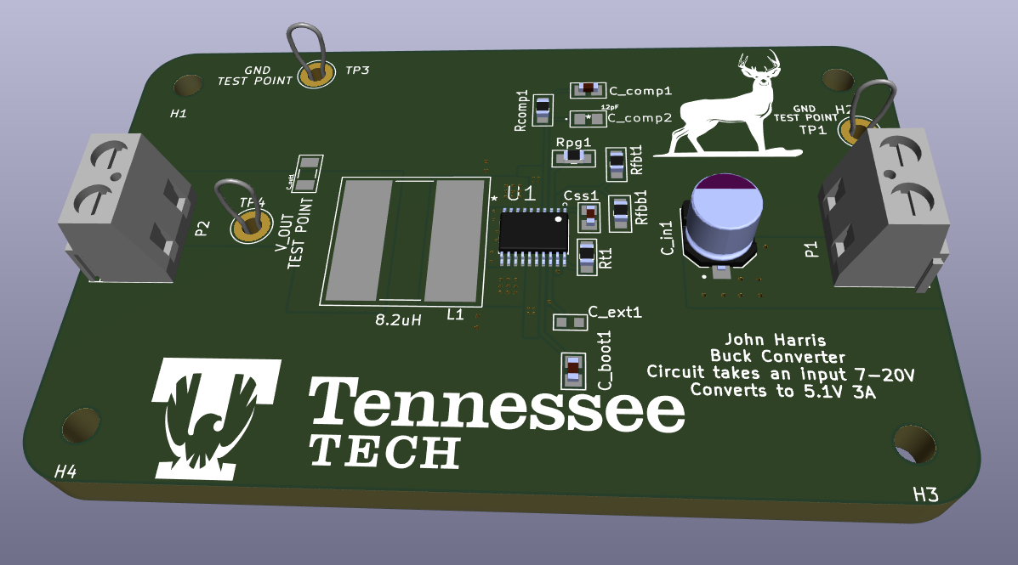
Power Subsystem
Versatility
Notes:
I designed the buck converters (which run the raspberry pi and arduinos) with Texas Instruments WeBench Power designer and laid them out in KiCad (KeeKad) schematic capture software, and assembled them by hand with the help of Mr. Conard Murray. They work with a wide range of input voltages for user convenience.
The power system has proven effective during our experimental test runs in the crawlspace environment supporting the Navigation, Environmental Sensing, and Movement subsystems that you will hear about next.”

Slide 7
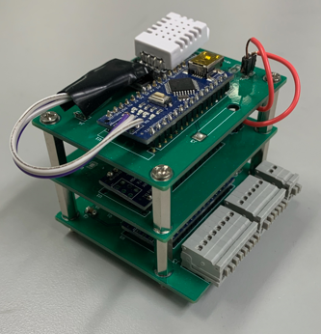
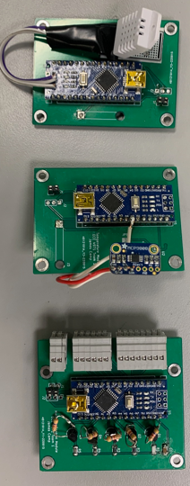
Environment Sensors Subsystem Capabilities

Slide 8
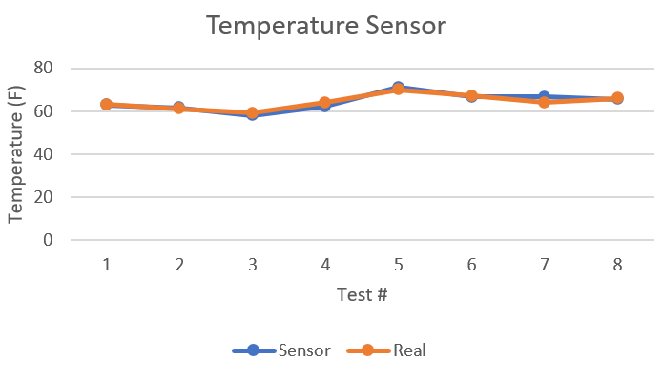
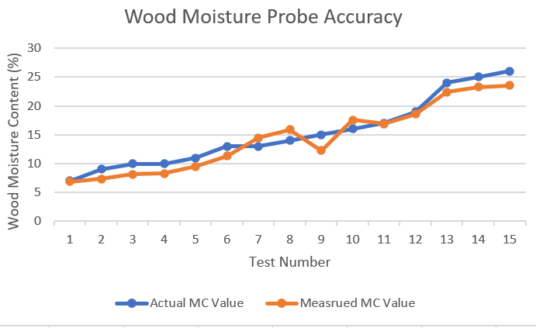
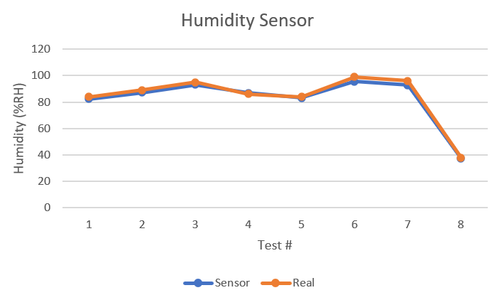
Environment Sensors Accuracy

Slide 9
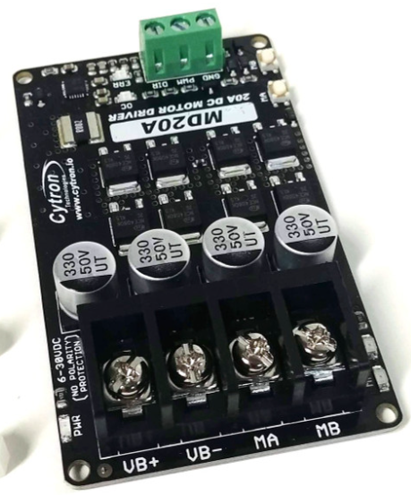
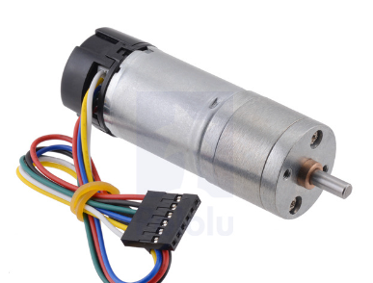
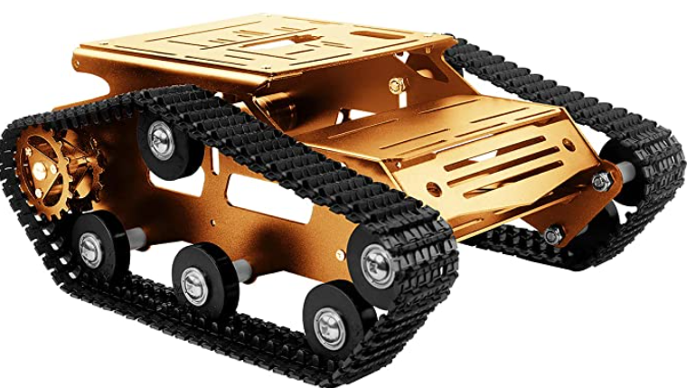
Movement Subsystem Capabilities
Navigation and Movement Programs Work Together
^{Motors, Drivers, and Encoders}
Notes:
List components…
Together the components in this Subsystem are the driving force for our robot.
Designing the Chassis for the Robot was another large part of this subsystem. The team started with a simple robotics kit from amazon, but then customized it to suit the needs of the project.
The original kit can be seen in the image here.
The Arduino in the movement system connects to the Pi in the navigation system via USB, and they communicate serially across that medium. Where the Pi sends directional instructions to the movement system and the arduino reports back with the robot’s speed.
The software within the arduino takes the direction input from the pi and then sends that to the motor drivers. The arduino also uses Pulse Width Modulation to set the rotational velocity of the motors, and then the interrupt pins on the board are used to measure the speed.
These DC gearmotors from Pololu come equipped with a quadrature hall effect encoder. The operation parameters are a no load RPM of 220 and a stall torque at 15 kg-cm and a stall current of 5 Amps.
Their power and signals are delivered through the Cytron MD20A. This H Bridge Motor Driver accepts PWM and direction signals and can handle a direct current of up to 20 Amps and has an operating voltage from 6-30 volts

Slide 10
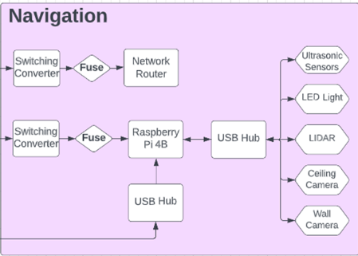
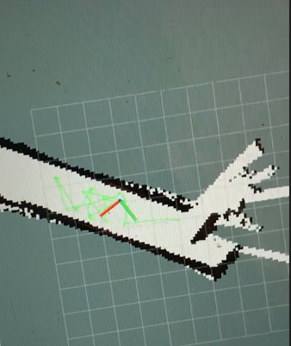
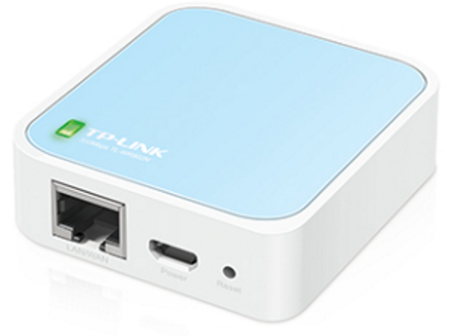
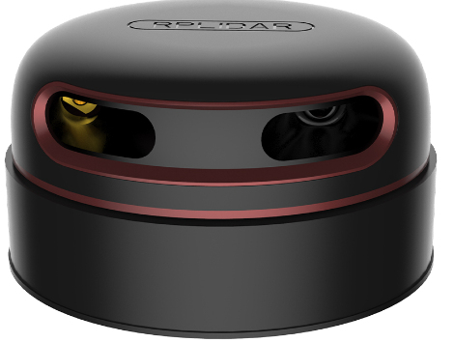
Navigation Subsystem Capabilities
Navigation Algorithms
RPi 4B, Arduino, & Ultrasonics
Python Based Wall Avoidance
Mapping Algorithms
Slamtec 360 Degree Lidar
Ubuntu, ROS, & Hector SLAM
Communication Protocol
TP-Link N300 Router
Windows Desktop Remote

Slide 11
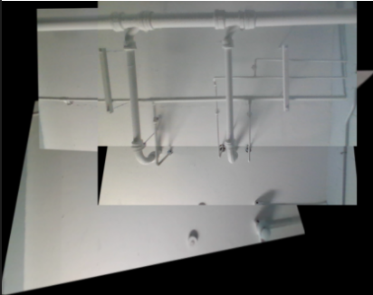
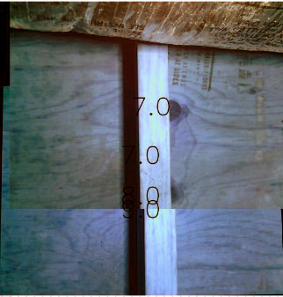
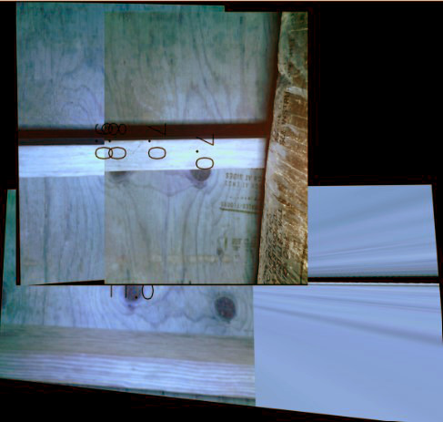
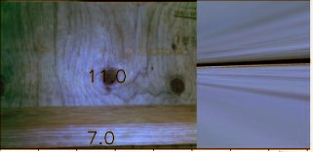
Image Stitching
Notes:
Crawlspace vs model
Issues with perspective and repeat parts
Sensing data

Slide 12
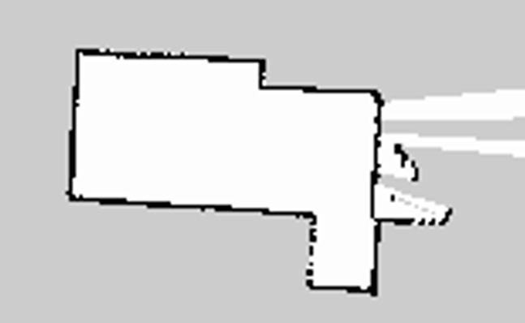
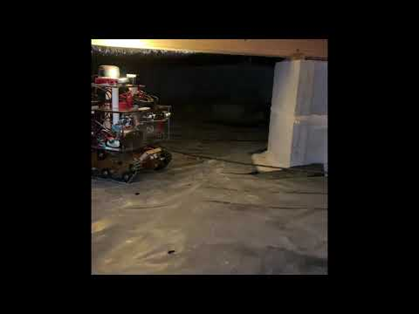

Final Crawl Space Experiment
Notes:
A variety of experiments were performed to determine the robot's functionality. Primarily, the team measured the robot's ability to accurately measure environmental data inside the crawlspace, how quickly the robot navigated the crawlspace, and the quality of the map and pictures that the robot formed as it maneuvered about the landscape.
Mention longer demo can be seen on youtube, dont wanna waste too much time on the video

Slide 13
Objectives For Future Work
ROS Based Autonomy Algorithms
Autonomous SLAM
Randomly Rapid Tree
Bug Wall
Mechanical/Chassis Improvements
Custom Chassis Design
Rubber Tracks
Speed Feedback Motor Controller
Arduino PID Compensator
Path Planning
Significant Image Stitching Improvements

Slide 14
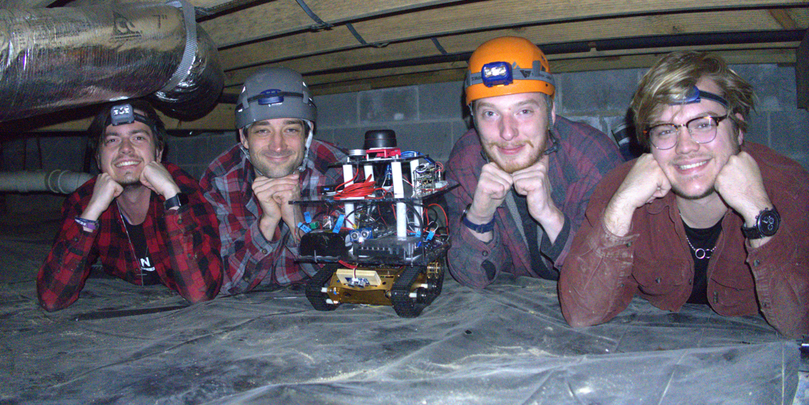
Questions?

